Slide 1

Expand course11-Infrared avoid
Yahboom
Yahboom Omibox Tutorial

Slide 2
Preparation-1
1
2
3
4
5
6
Learning
goals
Experimental
principle
Combine
blocks
Experimental
phenomena
Preparation
Search for
blocks
程序编程
Tencent
Yahboom Omibox Tutorial

Slide 3
1
Preparation-1
1. The position of the Infrared sensor in the robot car
2. Learn to understand the principle of Infrared follow
3. Learn how to use Infrared avoid sensor graphically program building blocks
Yahboom Omibox Tutorial

Slide 4
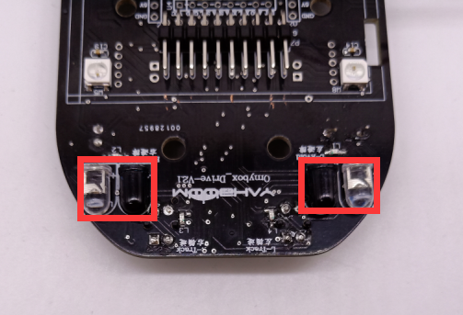
1
Preparation-2
As shown in the above picture, We circled the Infrared avoid sensor with two red wire frame. We can control them by programming.
Yahboom Omibox Tutorial

Slide 5
2
Learning goals
In this lesson we will learn how to complete the infrared avoid function of the robot car by programming.
Yahboom Omibox Tutorial

Slide 6
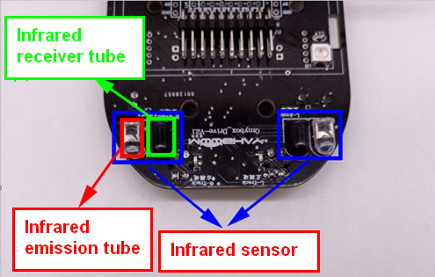
3
Experimental principle
The basic principle of the infrared sensor is to use the reflective nature of the object. When there is no obstacle in the front side, the infrared light emitted by the infrared sensor launching tube will gradually weaken due to the farther distance of the propagation, and finally disappear.
When there is an obstacle on the front side, the infrared light will be reflected to the receiving tube of the sensor.
We write the corresponding code according to this point to complete the robot infrared follow function.
Yahboom Omibox Tutorial

Slide 7
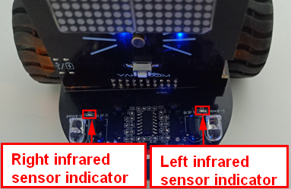
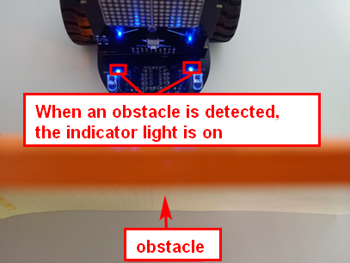
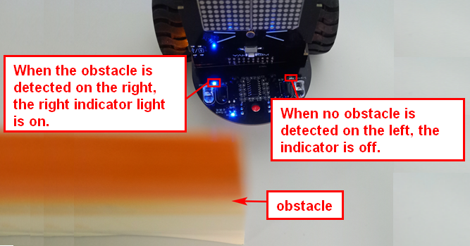
3
Experimental principle
Yahboom Omibox Tutorial

Slide 8
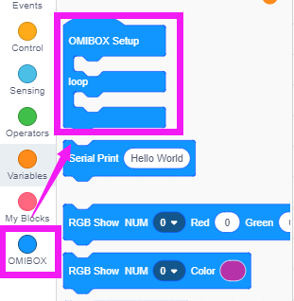
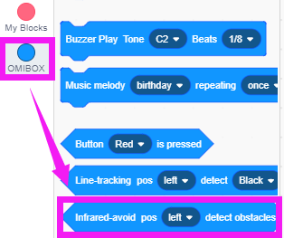
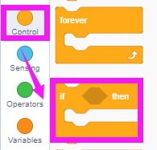
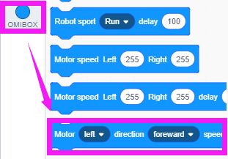
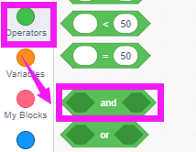
4
Search for blocks
The following is the location of the building blocks required for this programming.
Yahboom Omibox Tutorial

Slide 9
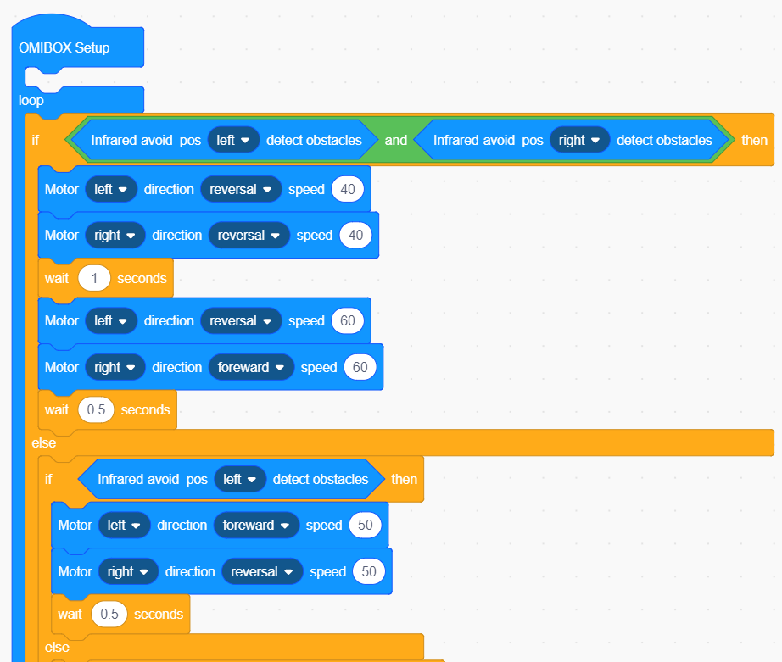
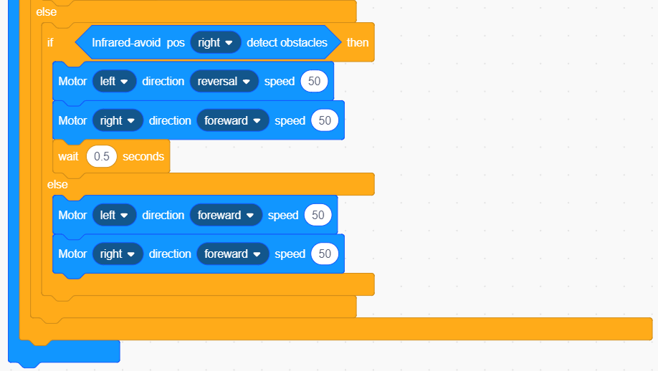
5
Combine blocks
The summary program is shown below:
Yahboom Omibox Tutorial

Slide 10
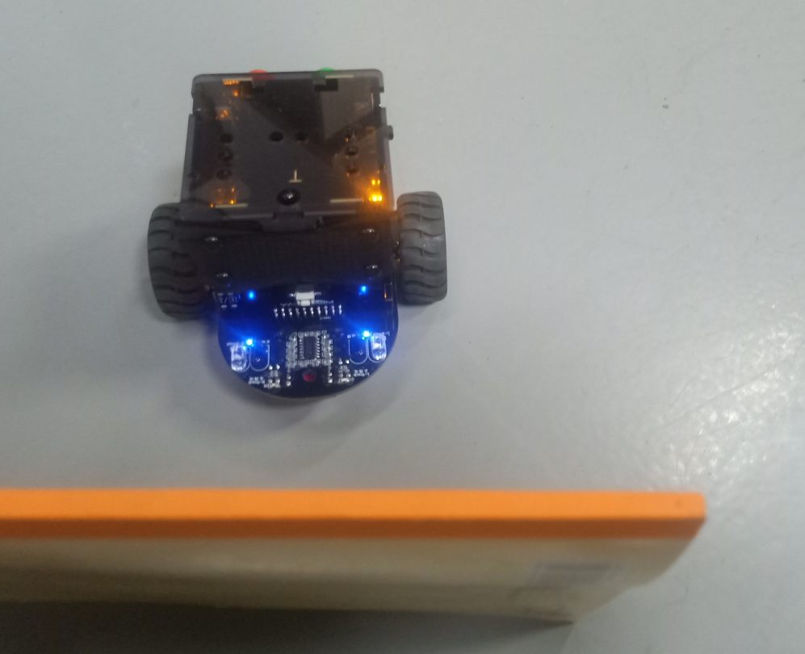

6
Experimental phenomena
After the program is uploaded, open the power of the Omibox. It will advance and automatically avoid obstacles when encountering obstacles.
In order to avoid the interference of sunlight on the infrared light, the experiment must be carried out indoors.
Yahboom Omibox Tutorial

Slide 11
Inspire Creativity Embrace Innovation
Thank you!!!
Yahboom

